Slide 1
Observed MEMS issues
22/07/2018

Slide 2
coverage
Checked at 30fps after projection
excluding margin
Varies between units (80%-87%)
Stable over temperature
Theoretical coverage should be close to 100%

Slide 3
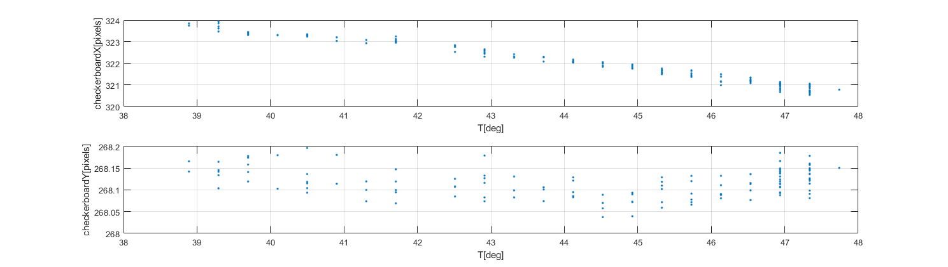
Temperature drift
Over checkerboard image, VGA@30FPS
40-47deg, capture each 5 sec
Visualize average checkerboard location

Slide 4
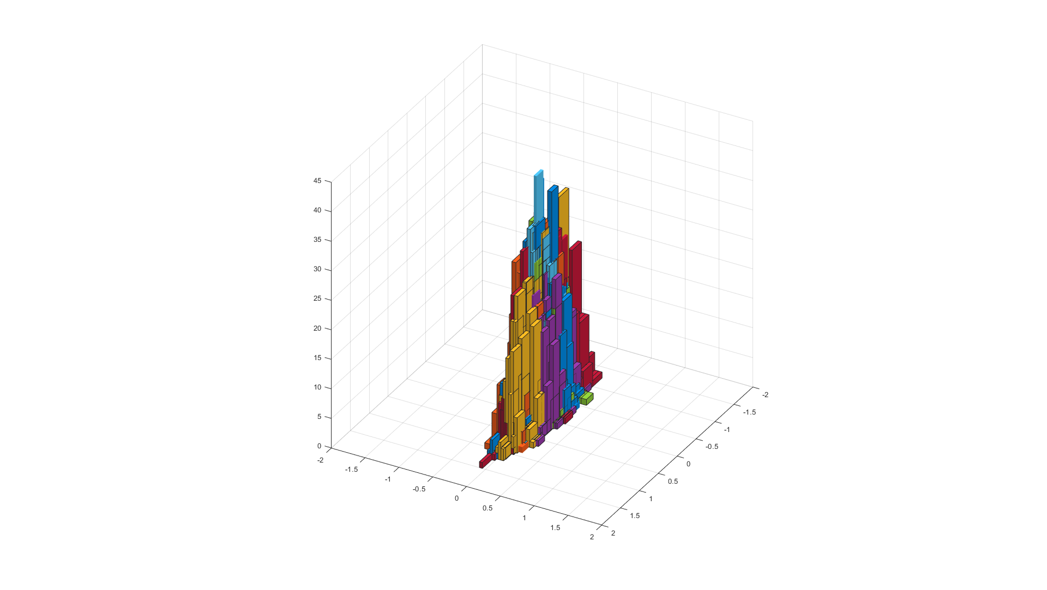
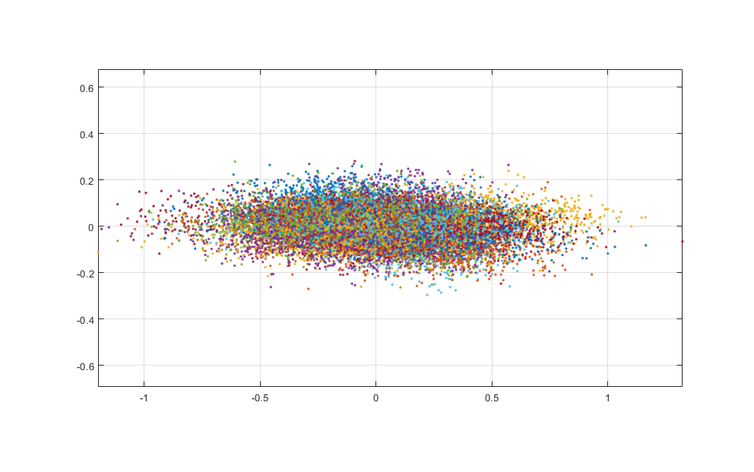
Temporal instability
Constant (max) temperature
visualizing the temporal location of each of the checkerboard point over time
No significant difference between points – all behave the same across the FOV
Instability of ±1 VGA pixel horizontal
Instability of ±0.25 VGA pixel vertical

Slide 5
Vertical LOS inaccuracy
Image bottom
Image center
Image top

Slide 6
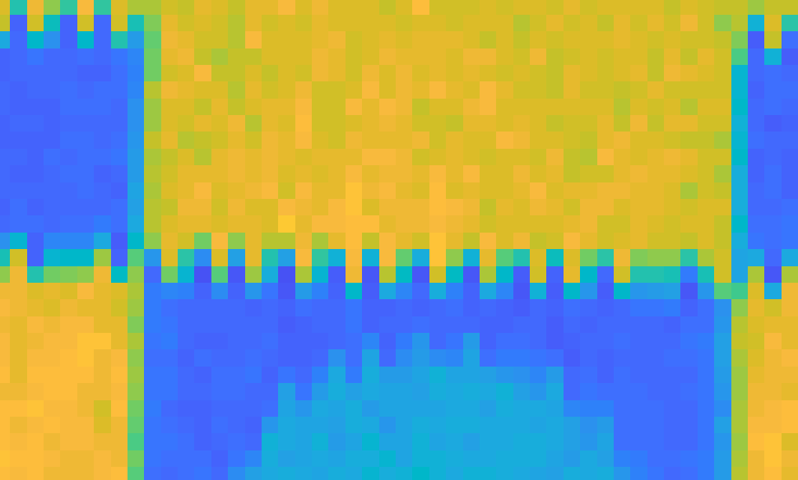
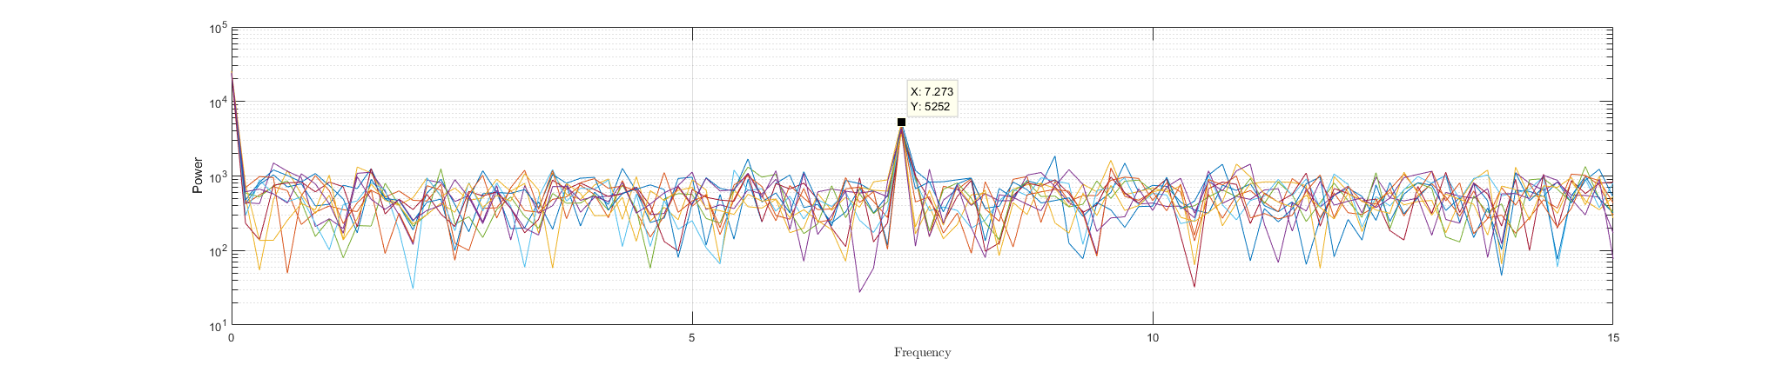
Tempo-spatial frequencies
Vertical edges miss-sync appears to move at a frequency of ~7Hz
Holes filled using 3x3 median filter
Constant across the frame
Harder to detect in synced areas

